Slide 1





标题文字标题文字
在这里写上你的标题
OpenStack Opportunities
and Challenges
For 2012 OpenStack APAC Conference at Beijing
副标题副标题副标题
副标题文字副标题文字
Cheng, Hui
freedomhui@gmail.com
Community Manager of COSUG
Technical Manager in Sina.com
2012/8/10
作者/日期
作者名字/日期

Slide 2



目录
Content
00
01
02
03
00
01
02
03
04
05
写上你的文字你的文字
OpenStack General Topics
Genesis, Strength, Chances and Challenges
OpenStack in Sina
Integration
Extension
New Services
Sina Contribution to OpenStack community

Slide 3
目录
00
01
02
03
00
01
02
03
04
05
写上你的文字你的文字
OpenStack Genesis

Slide 4

目录
In The Era of Virutalization
00
01
02
03
00
01
02
03
04
05
写上你的文字你的文字
is the King

Slide 5

目录
In The Era of Cloud
00
01
02
03
00
01
02
03
04
05
写上你的文字你的文字
is the defacto IaaS Standard

Slide 6





目录
They are commercial, closed and monopolistic, there are a lot of opensource solutions trying to compete with them:
00
01
02
03
00
01
02
03
04
05
写上你的文字你的文字
But they all fail until ...

Slide 7
In July 2010
目录
00
01
02
03
00
01
02
03
04
05
写上你的文字你的文字
is Born

Slide 8
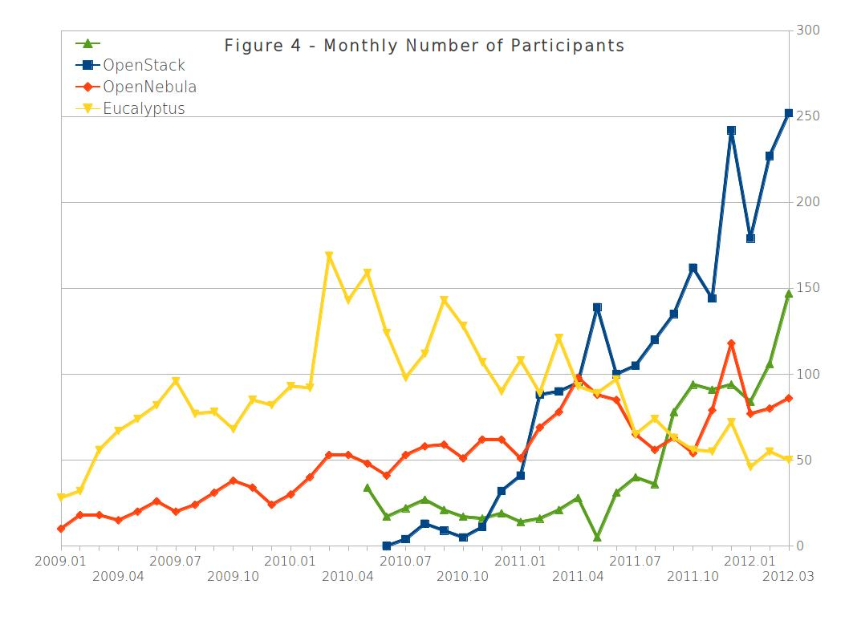
Fast Growth
目录
00
01
02
03
00
01
02
03
04
05
写上你的文字你的文字
Refer: Community Analysis — OpenStack vs OpenNebula vs Eucalyptus vs CloudStack http://www.qyjohn.net/?p=1856

Slide 9





















Evolving Ecosystem
目录
00
01
02
03
00
01
02
03
04
05
写上你的文字你的文字

Slide 10
Amazon's counterattack
目录
00
01
02
03
00
01
02
03
04
05
写上你的文字你的文字
Partner to enhance Compatibility

Slide 11

VMware's Redemption
目录
00
01
02
03
00
01
02
03
04
05
写上你的文字你的文字
$1.26 billion !

Slide 12

目录
OpenStack Strenth
00
01
02
03
00
01
02
03
04
05
写上你的文字你的文字

Slide 13
目录
00
01
02
03
00
01
02
03
04
05
写上你的文字你的文字
Open

Slide 14

Open Source
目录
00
01
02
03
00
01
02
03
04
05
写上你的文字你的文字
Apache 2 License

Slide 15
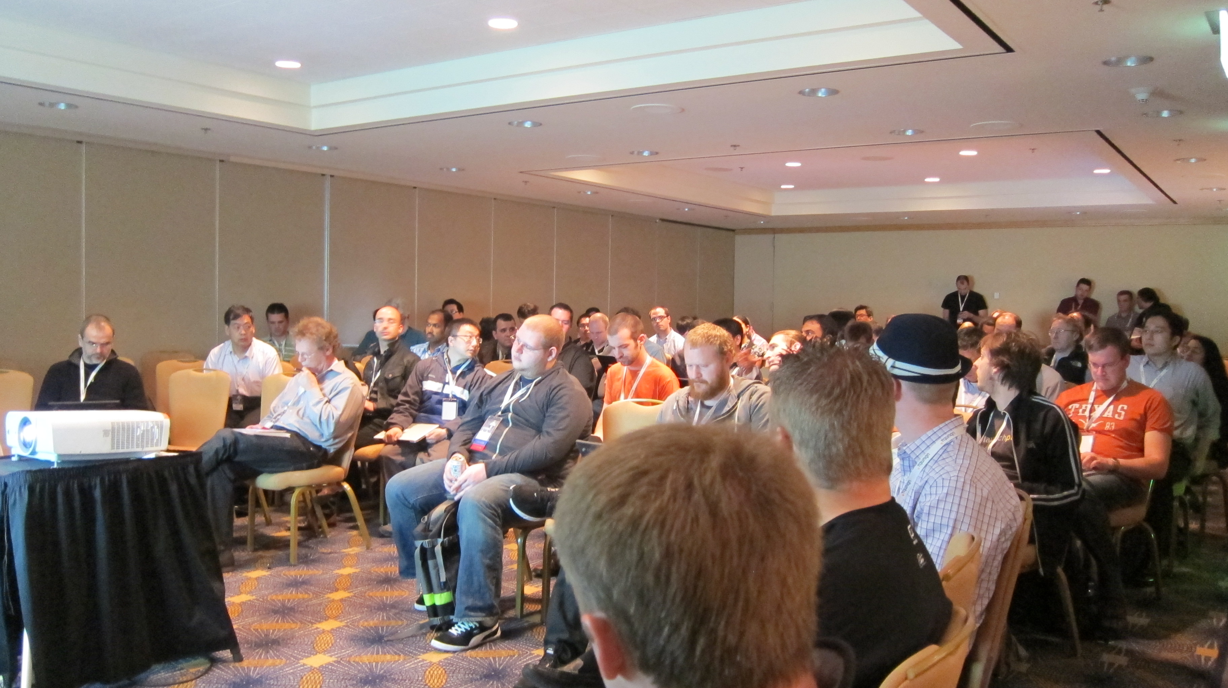
Open Design
目录
00
01
02
03
00
01
02
03
04
05
写上你的文字你的文字
Folsom Design Summit

Slide 16
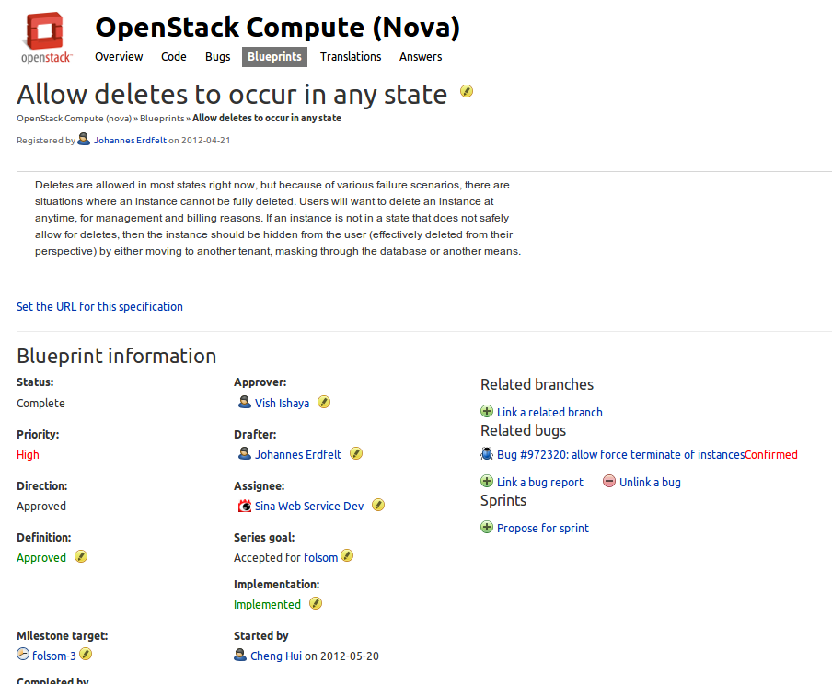
Open Development
目录
00
01
02
03
00
01
02
03
04
05
写上你的文字你的文字
Propose features in launchpad

Slide 17
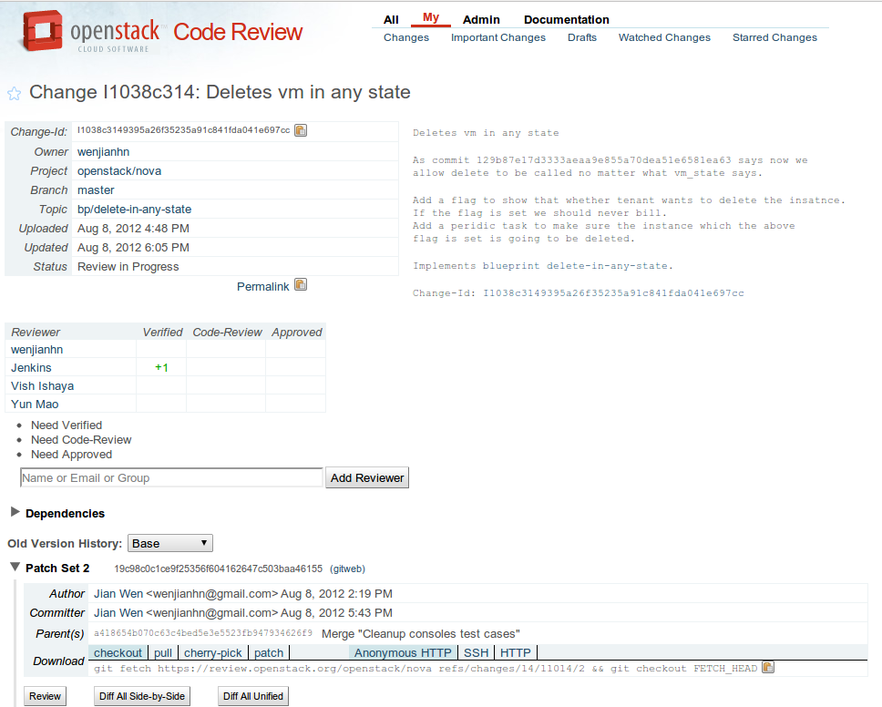
Open Development
目录
00
01
02
03
00
01
02
03
04
05
写上你的文字你的文字
Code Review

Slide 18
Open Community
目录
00
01
02
03
00
01
02
03
04
05
写上你的文字你的文字
IRC meeting are open to everyone
OpenStack Foundation

Slide 19
OpenStack Projects
目录
Core Projects
OpenStack Compute(Nova)
OpenStack Object Storage(Swift)
Image Service (Glance)
Identity (Keystone)
Dashboard (Horizon)
Network Connectivity (Quantum)
Community Projects
IP Management: Melange
Load Balancer: Altas-LB
Database as a Service: RedDwarf
Message Queue: Burrow
AWS | OpenStack
EC2 | nova
S3 | swift
EBS | nova-volume
ELB | Atlas-LB
SQS | Burrow
Console | Dashboard
IAM | Keystone
VPC | Quantum
RDS | RedDwarf
00
01
02
03
00
01
02
03
04
05
写上你的文字你的文字

Slide 20
目录
00
01
02
03
00
01
02
03
04
05
写上你的文字你的文字
OpenStack Chances

Slide 21
目录
00
01
02
03
00
01
02
03
04
05
写上你的文字你的文字
OpenStack is still far from being a "turnkey" solution

Slide 22





OpenStack Startups
目录
00
01
02
03
00
01
02
03
04
05
写上你的文字你的文字

Slide 23





OpenStack Public Cloud
目录
00
01
02
03
00
01
02
03
04
05
写上你的文字你的文字

Slide 24
Domestic Market
Domestic Market
目录
00
01
02
03
00
01
02
03
04
05
写上你的文字你的文字
Public Cloud
Aliyun, GrandCloud, SinaCloud…
Who will be the Chinese AWS ?
Private Cloud
No competitive candidates till now*
OpenStack based solution will sweep away the private market

Slide 25
目录
00
01
02
03
00
01
02
03
04
05
写上你的文字你的文字
OpenStack Chanlleges

Slide 26
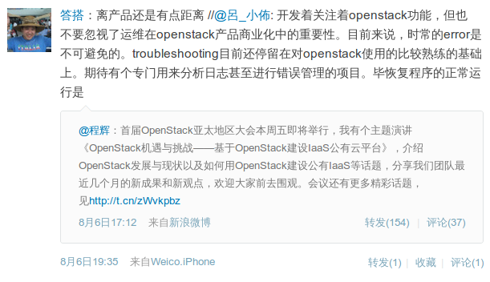
目录
00
01
02
03
00
01
02
03
04
05
写上你的文字你的文字

Slide 27
目录
00
01
02
03
00
01
02
03
04
05
写上你的文字你的文字
Shortage of OpenStack Telants

Slide 28
目录
00
01
02
03
00
01
02
03
04
05
写上你的文字你的文字
OpenStack in Sina

Slide 29


About SinaCloud
目录
00
01
02
03
00
01
02
03
04
05
First and most popular PaaS cloud in China, launched in 2009
Support PHP, Python and Java runtime
写上你的文字你的文字

Slide 30
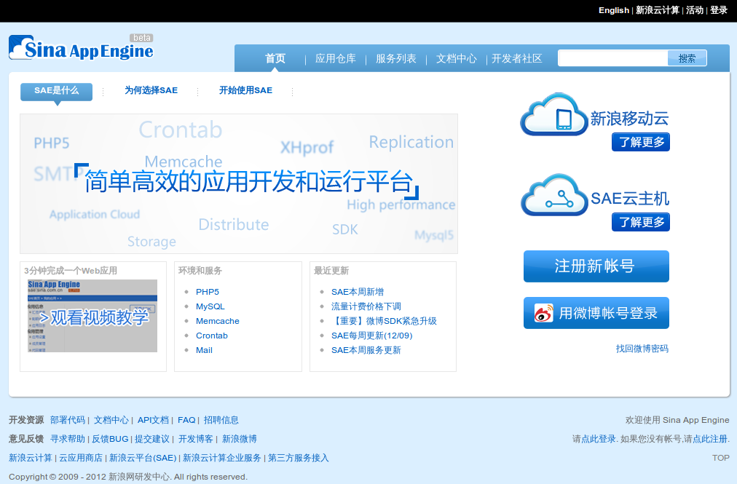
目录
00
01
02
03
00
01
02
03
04
05
写上你的文字你的文字

Slide 31

About SinaCloud
目录
00
01
02
03
00
01
02
03
04
05
First and most popular PaaS cloud in China, launched in 2009
Support PHP, Python and Java runtime
写上你的文字你的文字
OpenStack based public IaaS cloud

Slide 32
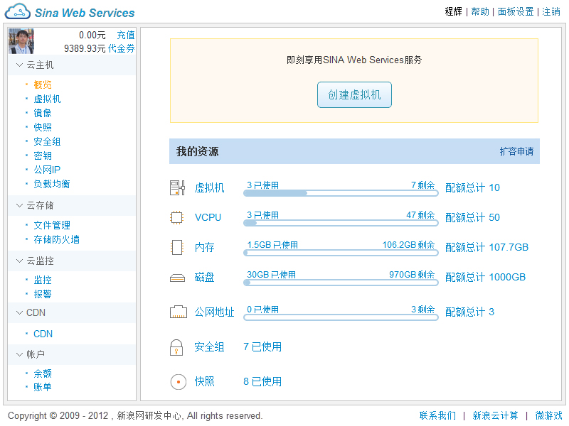
目录
00
01
02
03
00
01
02
03
04
05
写上你的文字你的文字

Slide 33

About SinaCloud
目录
00
01
02
03
00
01
02
03
04
05
First and most popular PaaS cloud in China, launched in 2009
Support PHP, Python and Java runtime
写上你的文字你的文字
OpenStack based public IaaS cloud
SaaS cloud based on SAE tech.
Design for the masses
1-Click buy and install apps
(SinaCloud Store)

Slide 34
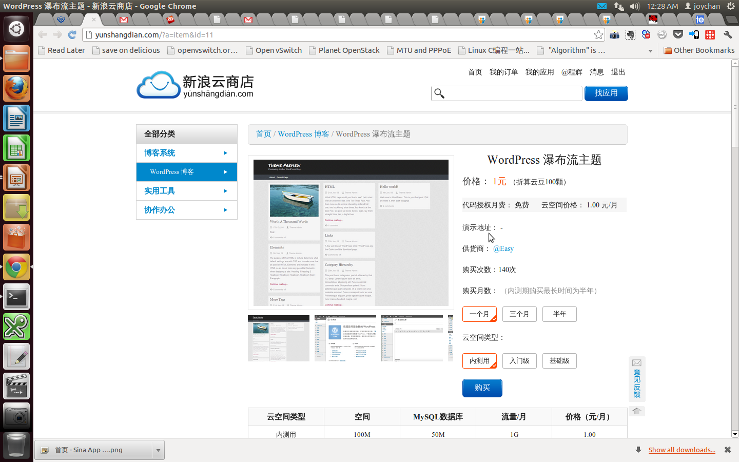
目录
00
01
02
03
00
01
02
03
04
05
写上你的文字你的文字
OpenStack in Sina

Slide 35
Sina Web Services(SWS)
目录
00
01
02
03
00
01
02
03
04
05
To salute Amazon Web Services
It's an validated and successful cloud business model.
Customers
Game makers on Weibo platform
Sina Partners
Common users out of Sina
Vision
Build an open and full-stack cloud ecosystem, integrated IaaS, PaaS and SaaS platform.
写上你的文字你的文字

Slide 36
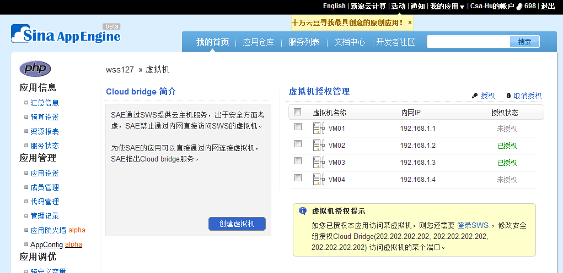
Cloud Bridge
目录
00
01
02
03
00
01
02
03
04
05
写上你的文字你的文字

Slide 37
SWS Deployment
目录
00
01
02
03
00
01
02
03
04
05
Rabbit
MySQL
写上你的文字你的文字
dashboard
schedule
nova-api
nova-compute
nova-network
nova-compute
nova-network
keystone
glance
Sina SSO
Swift

Slide 38
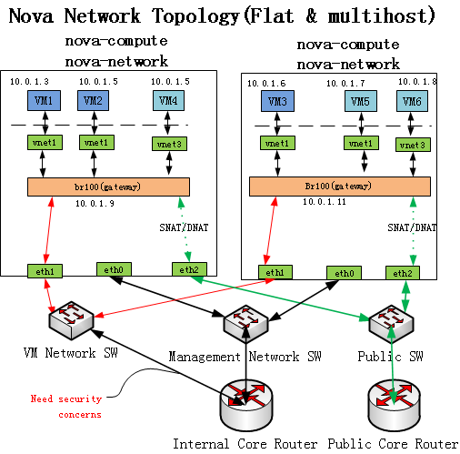
SWS Network Topology
目录
00
01
02
03
00
01
02
03
04
05
写上你的文字你的文字

Slide 39
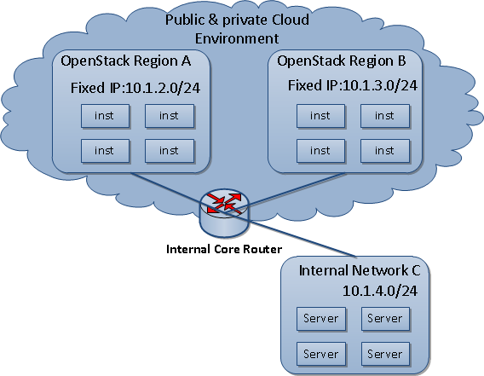
SWS Security Enhancement
目录
SWS Filter
Prevent Intranet Penetration
Intranet is the internal network outside of OpenStack
Egress filtering
Target is internal network
Source is instances in OpenStack
Implementation
Whitelist mechanism(ACCEPT rules)
On the top of nova-filter-top Forward Chain
00
01
02
03
00
01
02
03
04
05
写上你的文字你的文字

Slide 40
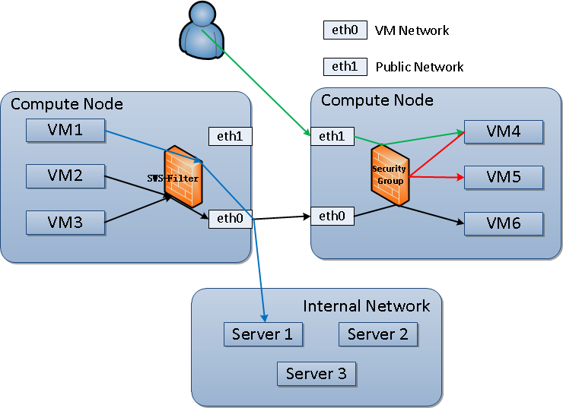
SWS Security Enhancement
目录
00
01
02
03
00
01
02
03
04
05
写上你的文字你的文字
Security Group VS SWS Filter

Slide 41
SWS Load Balancer
目录
Goals
Load Balance
Dispatch request
Support multiple routing algorithm
Health check
Acceleration
Reality: narrow bandwidth between ISPs
Building fiber channels from ISPs to pivot
Given the same endpoint within user’s ISP
IPv4 Shortage
Reality: dozens of public IPs support hundreds of VMs
IPv4 has been exhausted
IPv6 is not realistic yet in China
00
01
02
03
00
01
02
03
04
05
写上你的文字你的文字
DNS Acceleration Design
Smart DNS
Public Network
Telecom
Unicom
Mobile
Others ISP
High speed fiber-optic
Router

Slide 42
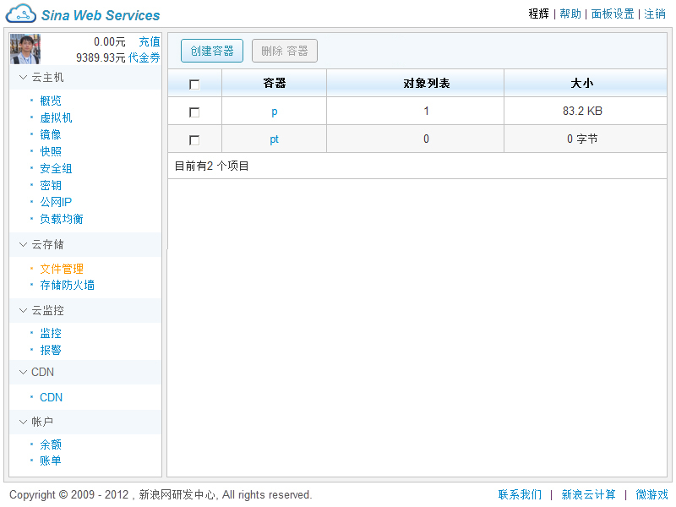
Object Storage
目录
00
01
02
03
00
01
02
03
04
05
写上你的文字你的文字

Slide 43
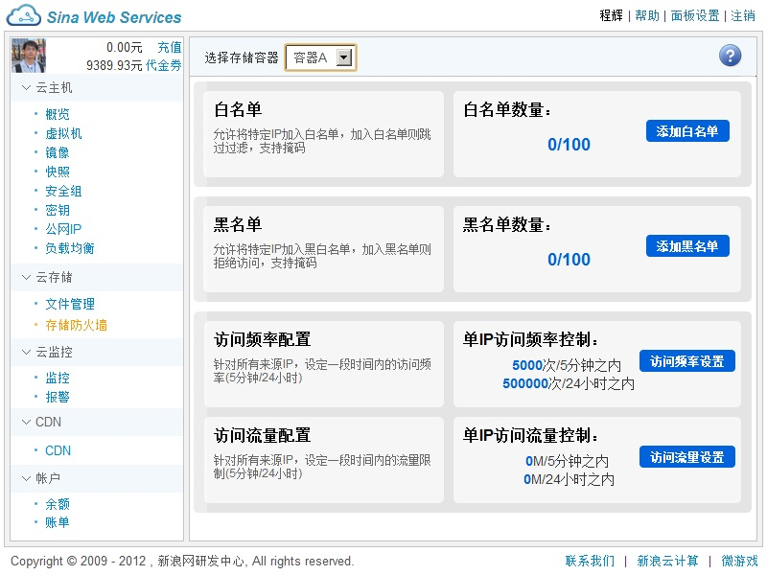
Storage Firewall
目录
00
01
02
03
00
01
02
03
04
05
写上你的文字你的文字

Slide 44



SWS continuas integration
目录
00
01
02
03
00
01
02
03
04
05
写上你的文字你的文字

Slide 45
Sina Contribution
目录
Sina creating OpenStack community project Dough & Kanyun,
to contribute metering & billing capability
Present in OpenStack Design Summit & Conference
Claim and submit dozens of blueprints in OpenStack Launchpad
Top 10 Companies by bugfixes
00
01
02
03
00
01
02
03
04
05
写上你的文字你的文字

Slide 46
What's the kanyun
目录
00
01
02
03
00
01
02
03
04
05
写上你的文字你的文字
Monitoring tools
Tracking the tenant resource usage:
CPU、mem、disk、network traffic
Metering tools
Data collection and statistics

Slide 47
Kanyun: Monitoring system
目录
Nova
Compute
Worker
00
01
02
03
00
01
02
03
04
05
Nova
Compute
Dashboard
写上你的文字你的文字
Worker
API daemon
Retrieve usage info
Responds to client request
Billing
Aggregator
NoSQL
Calculates/stores metrics
https://github.com/sinacloud/kanyun (updated at 8/9)

Slide 48
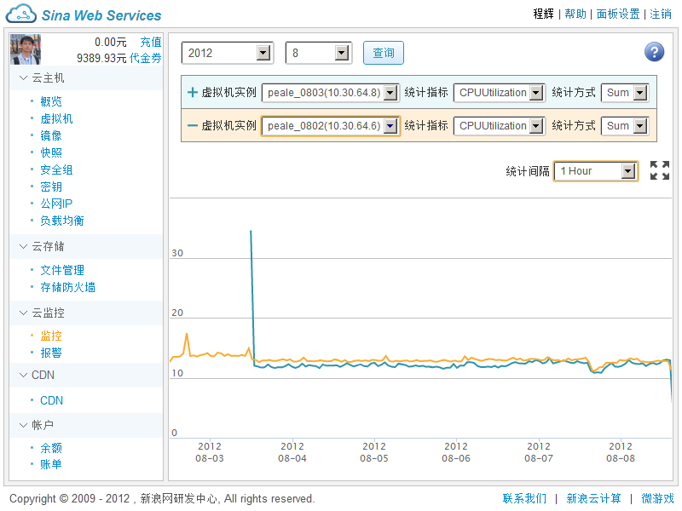
What's the kanyun
目录
00
01
02
03
00
01
02
03
04
05
写上你的文字你的文字

Slide 49
Dough:Billing system
目录
00
01
02
03
00
01
02
03
04
05
写上你的文字你的文字
Keep track of billing info to charge tenants
Flexible customization of payment policies
How much/often to charge for resource unit
Handles prepaid or pay-as-you-go
Coupon Support

Slide 50
Dough:Billing system
目录
deduct
00
01
02
03
00
01
02
03
04
05
RDBMS
写上你的文字你的文字
Kanyun API
(Metering)
Dashboard
Farmer
API daemon
NoSQL
Check status /
Retrieve usage /
Create purchases
Subscribe or
unsubscribe
Query info
https://github.com/sinacloud/dough (updated at 8/9)

Slide 51
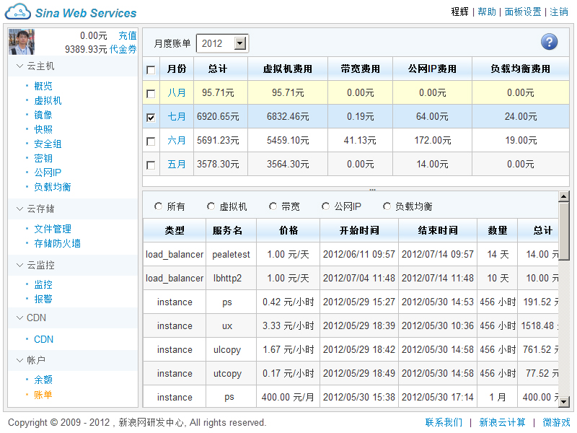
Dough:Billing system
目录
00
01
02
03
00
01
02
03
04
05
写上你的文字你的文字

Slide 52
SWS Future Plan(Within Folsom)
目录
00
01
02
03
00
01
02
03
04
05
写上你的文字你的文字
Open API
vMotion
High Availability
Fault Tolerance
EBS
Quantum Integration
Multi-IDC Support

Slide 53
目录
00
01
02
03
00
01
02
03
04
05
写上你的文字你的文字
Thank you, OpenStack Community and Foundation.

Slide 54
目录
00
01
02
03
00
01
02
03
04
05
写上你的文字你的文字
Thanks!
Q & A
Weibo: @程辉
freedomhui@gmail.com

